Slide 1
Mid-state Shuttle service
Team Revan

Slide 2
MEET OUR TEAM
Nic
Phoo
Alexis
Nathan
Product Owner/Scrum Master
Developer
Developer
Developer

Slide 3
Project Overview
- Optimize and simplify
- Centralize data collection
- Eliminating most manual data entry

Slide 4
Project Overview
- Unified Interface for riders
- Enhance user efficiency

Slide 5
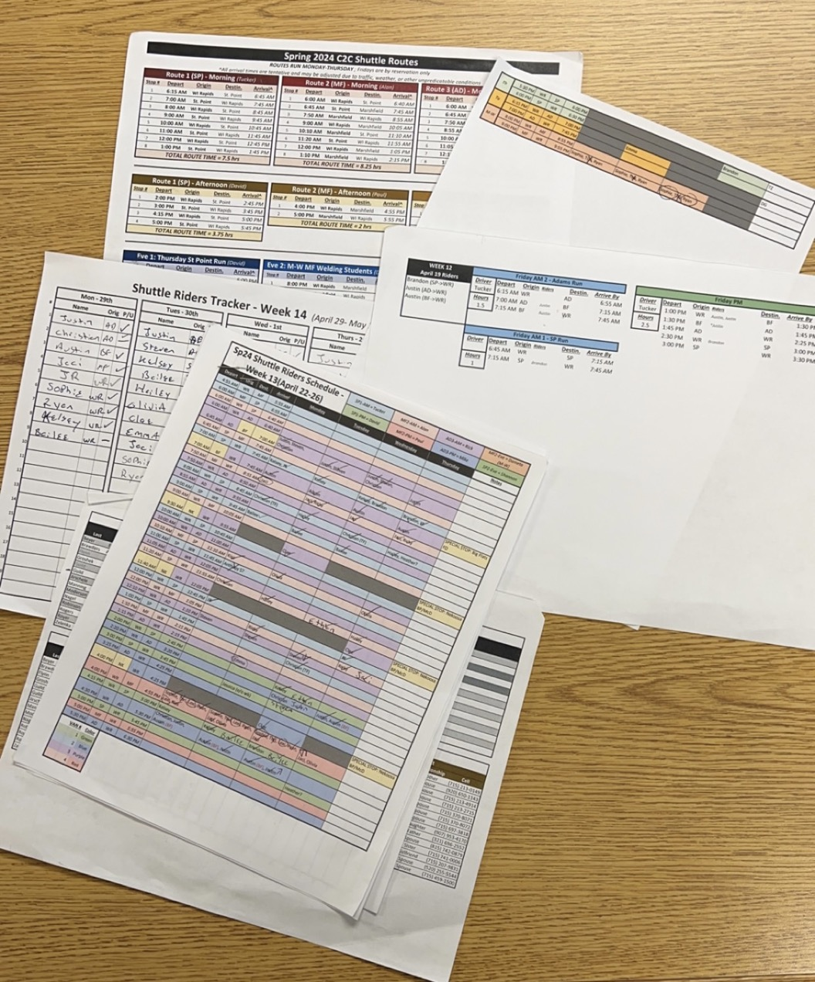
- maintaining papers to track each route - Recorded manually and inputted into spreadsheets -Changes to routes require updates to reservation and schedule forms
Current Process

Slide 6
Rider Experience - Riders access a separate Cognito form to request rides - existing system lacks an efficient method for riders to contact dispatch
Current Process

Slide 7
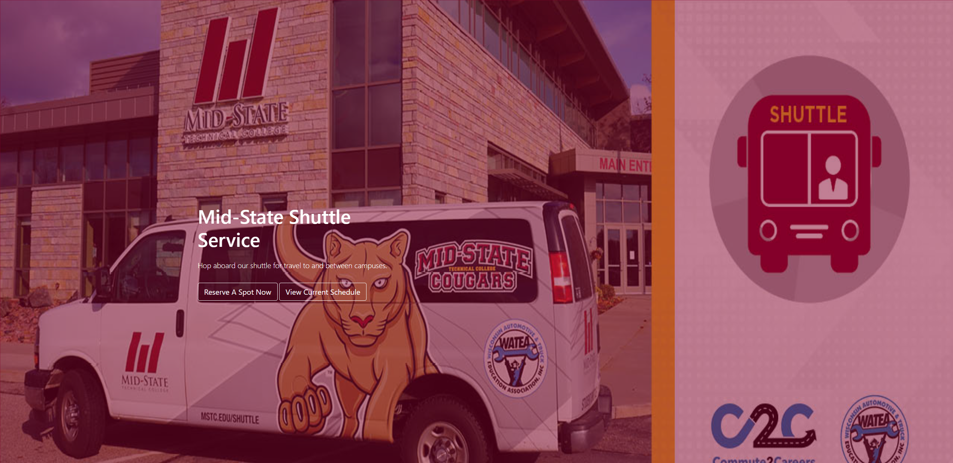
DEMO

Slide 8
To wrap it up
Eliminate the time manually updating records
Optimize data collection
Unified interface for riders to Register/Check-In
Enhance efficiency across the application

Slide 9
Questions?

